Slide 1
DATA VISUALIZATION
INSIGHT BEHIND DATA
Mukul Taneja
Data Specialist, Gramener

Slide 2
WHAT IS BIG DATA ?
Volume: Organizations collect data from a variety of sources, including business transactions, social media and information from sensor or machine-to-machine data. In the past, storing it would’ve been a problem – but new technologies (such as Hadoop) have eased the burden.
Velocity: Data streams in at an unprecedented speed and must be dealt with in a timely manner. RFID tags, sensors and smart metering are driving the need to deal with torrents of data in near-real time.
Variety: Data comes in all types of formats – from structured, numeric data in traditional databases to unstructured text documents, email, video, audio, stock ticker data and financial transactions.

Slide 3
BIG DATA also is…
Extremely large data sets that may be analysed computationally to reveal patterns, trends, and associations, especially relating to human behaviour and interactions
Which data is “BIG”?
Google Services
Social Media
E-Commerce
Geo-location and many more…

Slide 4
WHY CARE FOR DATA ?
DATA IS EVERYWHERE.
As users are continuously increasing, amount of data is getting massive.

Slide 5
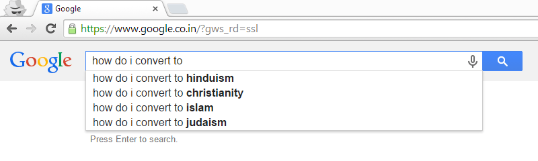
HOW TO USE DATA ?
To predict the user behavior…

Slide 6
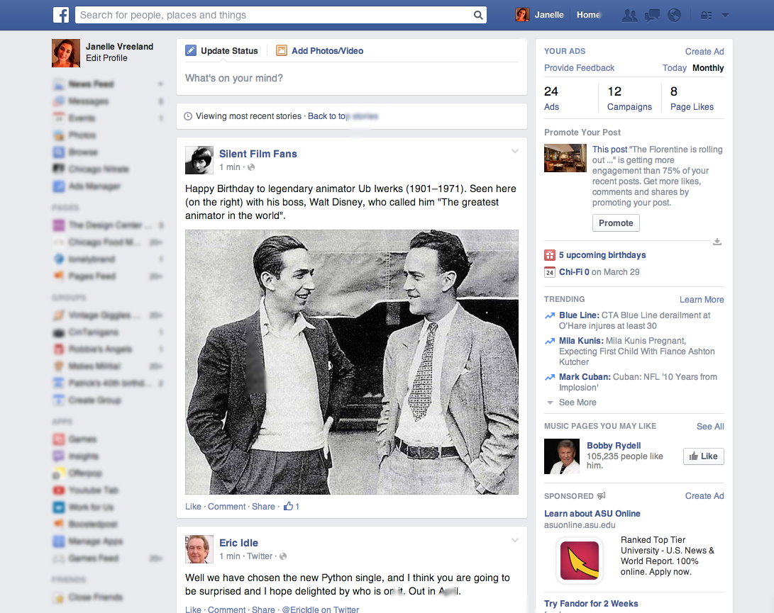
HOW TO USE DATA ?
To make connectivity better…

Slide 7
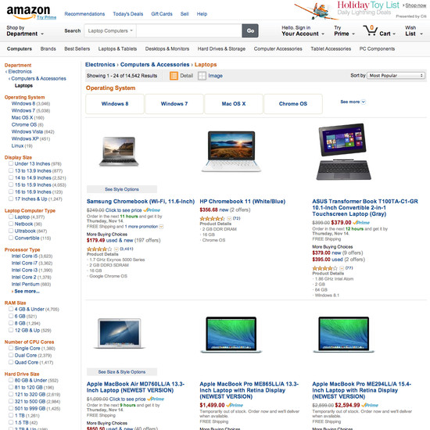
HOW TO USE DATA ?
To provide better products to buy….

Slide 8
And the whole idea is ….
To give user…
Better experience
Accuracy
Relevancy
Productivity
Opportunity
Reliability

Slide 9
WHAT TO DO WITH DATA ?
DATA
Insight
IS EVERYWHERE
ANALYSIS
VISUALIZE

Slide 10
WHY SHOULD WE VISUALIZE THE DATA?
We humans do not understand the language of raw DATA

Slide 11

“
We have internal information. Getting information from outside is our challenge. There’s no way of doing that.
– Senior Editor Leading Media Company

Slide 12
There are many ways to aid data consumption
Just
expose
the data to me
Allow me to
explore
and figure it out
High effort
Consumer
SHOW
me what is happening with the data
Explain
to me why it’s happening
Low effort
Low effort
High effort
Creator

Slide 13
Just
expose
the data to me
Allow me to
explore
and figure it out
SHOW
me what is happening with the data
Explain
to me why it’s happening

Slide 14
RELIGIONS IN INDIA

Slide 15
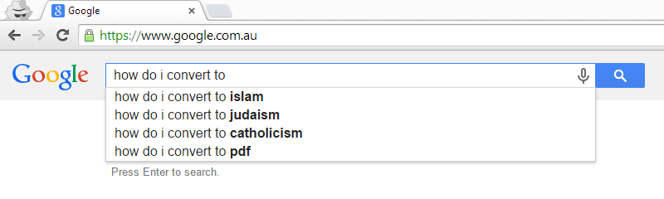
RELIGIONS IN AUSTRALIA

Slide 16
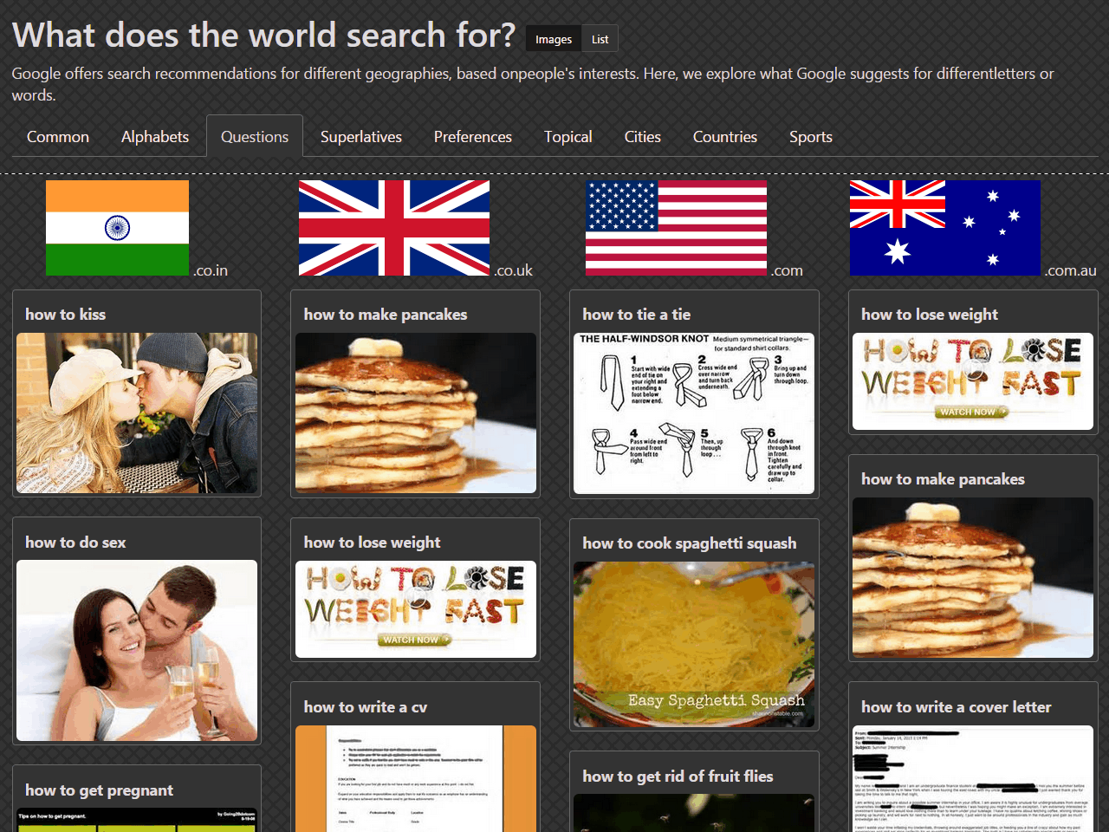

Slide 17
LET’S TAKE TESCO’S GROCERIES
category | title | kJ | rate
dairy | Activia Pouring Natural Yogurt 1X950g | 216 | 0.21
dairy | Activia Pouring Strawberry Yogurt 1X950g | 250 | 0.21
dairy | Activia Pouring Vanilla Yogurt 1X950g | 263 | 0.21
icecream | Almondy Daim 400G | 1804 | 0.75
icecream | Almondy Toblerone 400G | 1850 | 0.5
cereals | Alpen 10 Pack Lite Summer Fruits Cereal Bars 210G | 1222 | 1.57
cereals | Alpen 10Pk Fruit Nut And Chocolate Cereal Bars 290G | 1812 | 1.14
cereals | Alpen Coconut And Chocolate Cereal Bars 5Pk 145G | 1863 | 1.24
cereals | Alpen Fruit And Nut With Chocolate Cereal Bar 5X29g | 1812 | 1.24
cereals | Alpen High Fruit 650G | 1439 | 0.4
cereals | Alpen Light Bars Chocolate And Orange 5X21g | 1246 | 1.71
cereals | Alpen Light Chocolate And Fudge Bar 5X21g | 1264 | 1.71
cereals | Alpen Light Sultana & Apple Bars 5Pk 105G | 1197 | 1.71
cereals | Alpen Light Summer Fruits Bars 5Pk 105G | 1222 | 1.71
cereals | Alpen No Added Sugar 1.3Kg | 1488 | 0.31
cereals | Alpen No Added Sugar 560G | 1488 | 0.46
cereals | Alpen Original 1.5Kg | 1509 | 0.27
cereals | Alpen Original Muesli 750G | 1509 | 0.35
cereals | Alpen Raspberry And Yoghurt Cereal Bars5x29g | 1748 | 1.24
cereals | Alpen Strawberry With Yoghurt Cereal Bar 5X29g | 1756 | 1.24
dairy | Alpro Natural Yofu 500G |  | 0.28
dairy | Alpro Raspberry Vanilla Yofu 4X125g |  | 0.35
dairy | Alpro Strawberry And Fof Soya Yofu 4X125g |  | 0.35
dairy | Alpro Vanilla Yofu 500G |  | 0.28

Slide 18
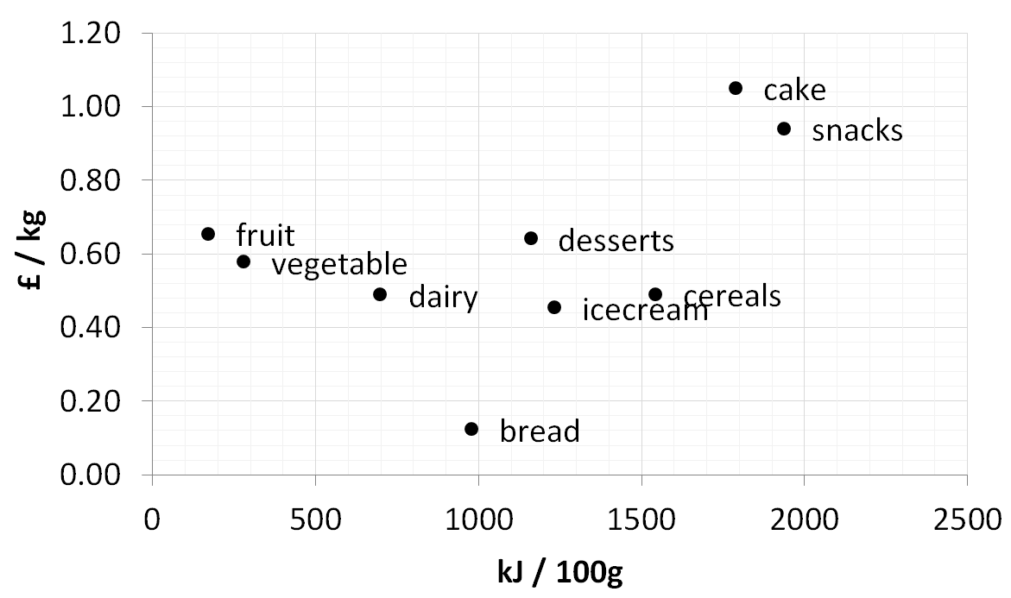

Slide 19
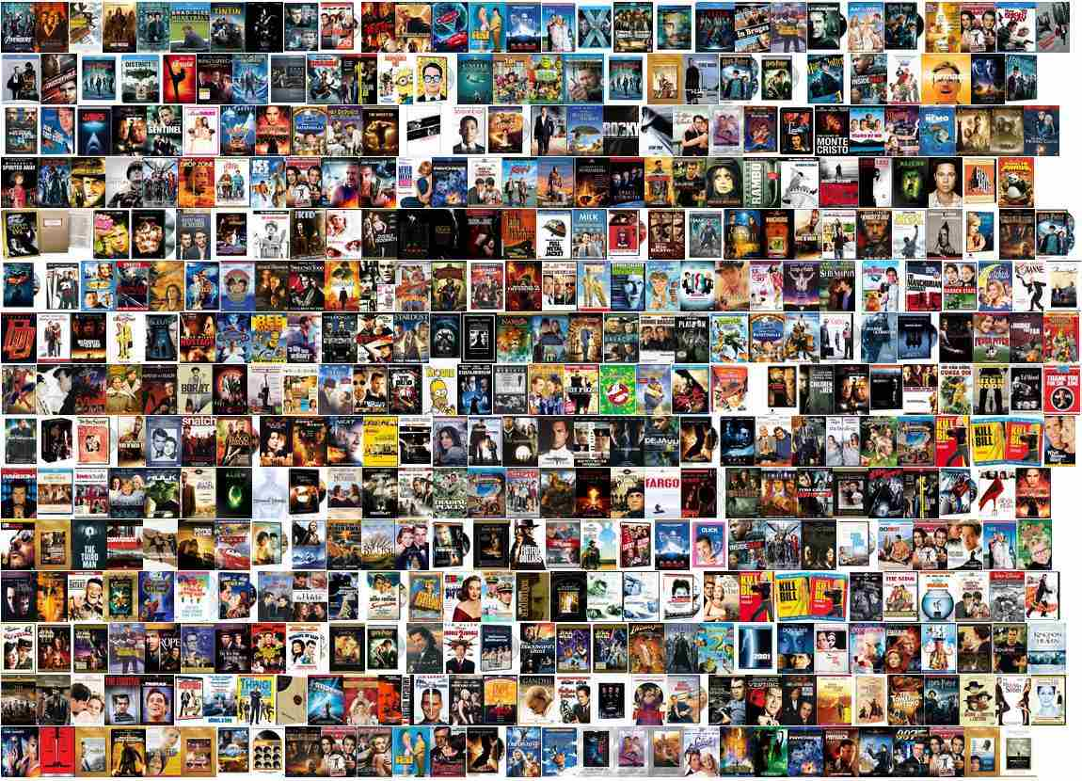

Slide 20
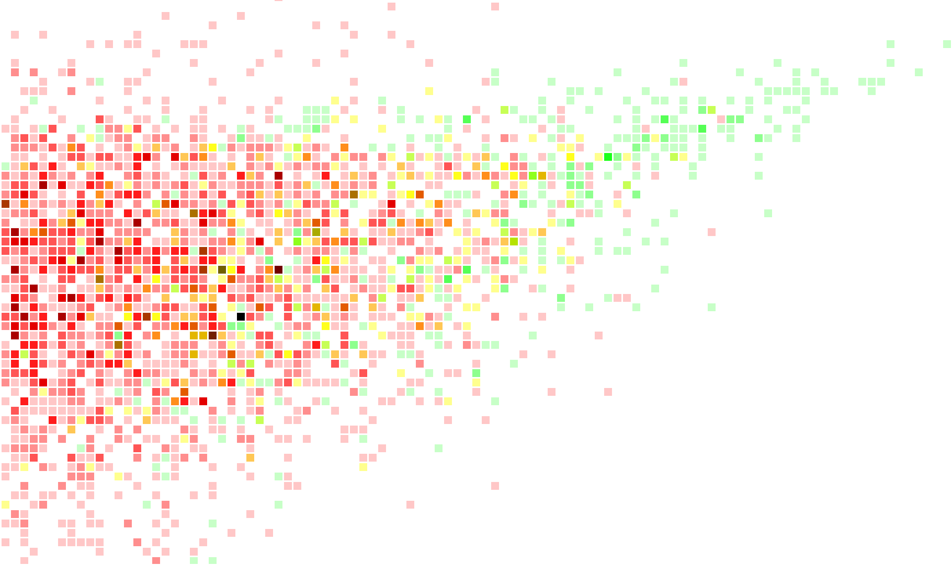
MOVIES ON THE IMDB
MORE VOTES
The Shawshank Redepmption
BETTER RATED
The Good, The Bad, The Ugly
The Godfather
12 Angry Men
Yojinbo
Rang De Basanti
7 Samurai
The Dark Knight
3 Idiots
Taare Zameen Par
Titanic
Transformers
The Phantom Menace
Twilight
New Moon
Many unwatched movies
Few unwatched movies
Mix of watched & unwatched
Few watched movies
Many watched movies
Wild Wild West

Slide 21
Just
expose
the data to me
Allow me to
explore
and figure it out
SHOW
me what is happening with the data
Explain
to me why it’s happening
Simplifying access to data is a big win

Slide 22
Just
expose
the data to me
Allow me to
explore
and figure it out
SHOW
me what is happening with the data
Explain
to me why it’s happening

Slide 23
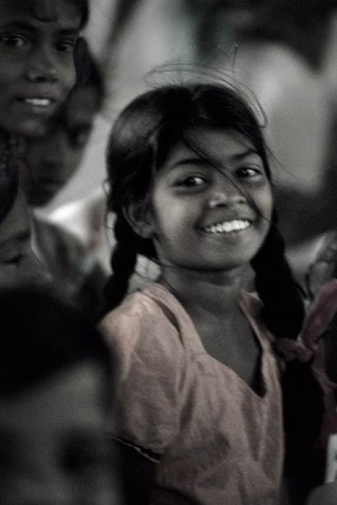
Predicting marks
What determines a child’s marks?
Do girls score better than boys?
Does the choice of subject matter?
Does the medium of instruction matter?
Does community or religion matter?
Does their birthday matter?
Does the first letter of their name matter?
Education

Slide 24
TN Class X: English

Slide 25
TN Class X: Social Science

Slide 26
TN Class X: Mathematics

Slide 27
Just
expose
the data to me
Allow me to
explore
and figure it out
SHOW
me what is happening with the data
Explain
to me why it’s happening
… to make the hidden obvious

Slide 28
Just
expose
the data to me
Allow me to
explore
and figure it out
SHOW
me what is happening with the data
Explain
to me why it’s happening

Slide 29
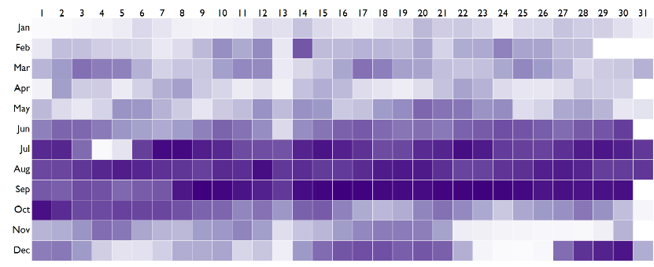
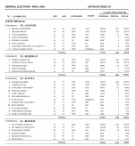
Let’s look at 15 years of US Birth Data
This is a dataset (1975 – 1990) that has been around for several years, and has been studied extensively. Yet, a visualization can reveal patterns that are neither obvious nor well known.
For example,
Are birthdays uniformly distributed?
Do doctors or parents exercise the C-section option to move dates?
Is there any day of the month that has unusually high or low births?
Are there any months with relatively high or low births?
More births
Fewer births
… on average, for each day of the year (from 1975 to 1990)
Some special days like April Fool’s day are avoided, but Valentine’s Day is quite popular
Most people prefer not to have children on the 13th of any month, given that it’s an unlucky day
Relatively few births during the Christmas and Thanksgiving holidays, as well as New Year and Independence Day.
Very high births in September. But this is fairly well known. Most conceptions happen during the winter holiday season

Slide 30
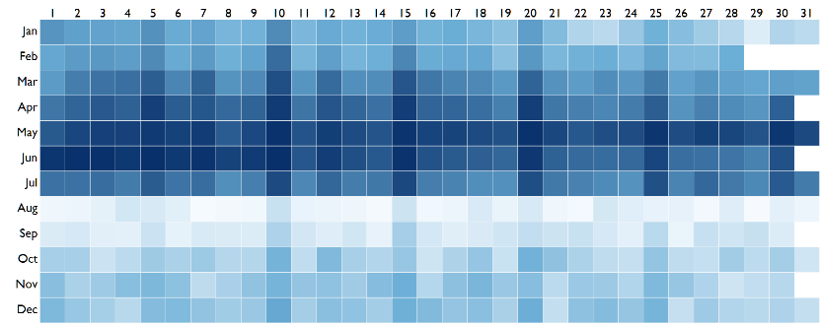
The pattern in India is quite different
This is a birth date dataset that’s obtained from school admission data for over 10 million children. When we compare this with births in the US, we see none of the same patterns.
For example,
Is there an aversion to the 13th or is there a local cultural nuance?
Are holidays avoided for births?
Which months have a higher propensity for births, and why?
Are there any patterns not found in the US data?
More births
Fewer births
… on average, for each day of the year (from 2007 to 2013)
Such round numbered patterns a typical indication of fraud. Here, birthdates are brought forward to aid early school admission
We see a large number of children born on the 5th, 10th, 15th, 20th and 25th of each month – that is, round numbered dates
Very few children are born in the month of August, and thereafter. Most births are concentrated in the first half of the year

Slide 31
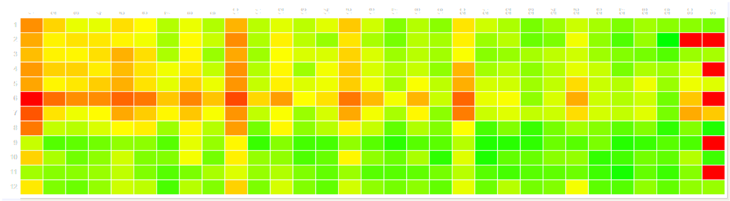
This adversely impacts children’s marks
It’s a well established fact that older children tend to do better at school in most activities. Since many children have had their birth dates brought forward, these younger children suffer.
The average marks of children “born” on the 1st, 5th, 10th, 15th etc. of the month tend to score lower marks.
Are holidays avoided for births?
Which months have a higher propensity for births, and why?
Are there any patterns not found in the US data?
Higher marks
Lower marks
… on average, for children born on a given day of the year (from 2007 to 2013)
Children “born” on round numbered days score lower marks on average,
due to a higher proportion of younger children

Slide 32
Just
expose
the data to me
Allow me to
explore
and figure it out
SHOW
me what is happening with the data
Explain
to me why it’s happening

Slide 33
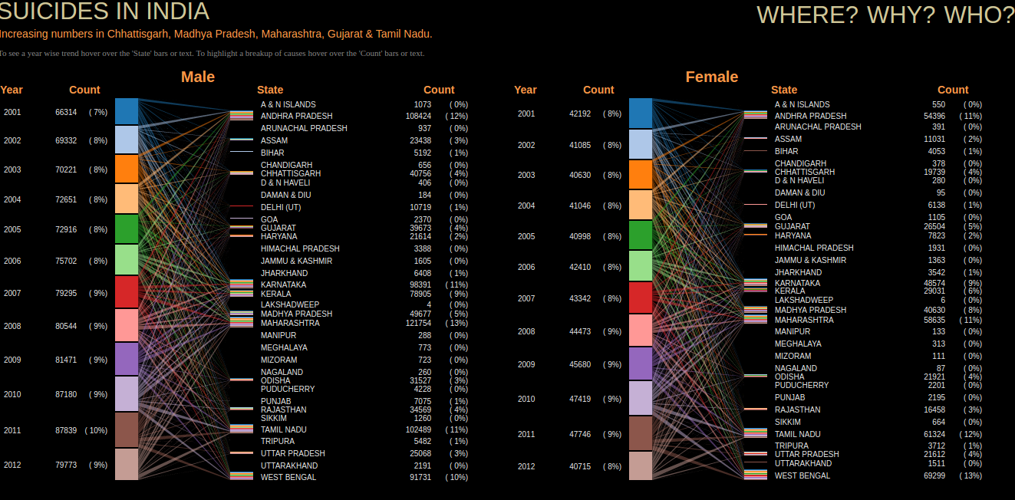
SUICIDES IN INDIA

Slide 34
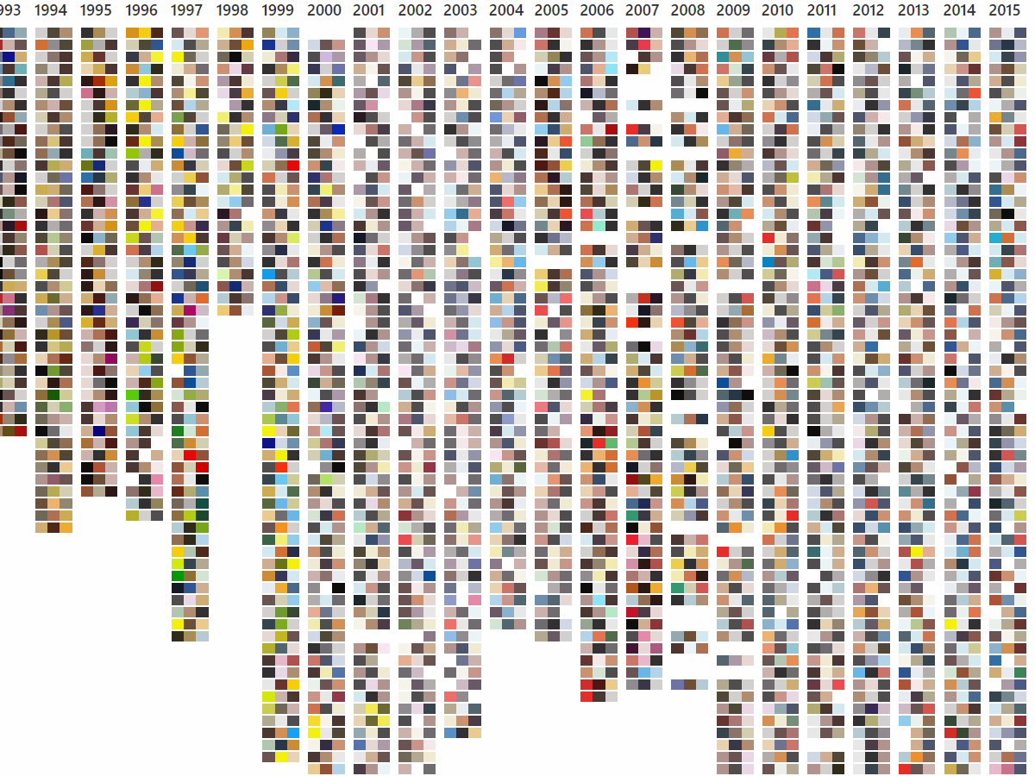

UTTERLY, BUTTERLY, COLORFUL

Slide 35
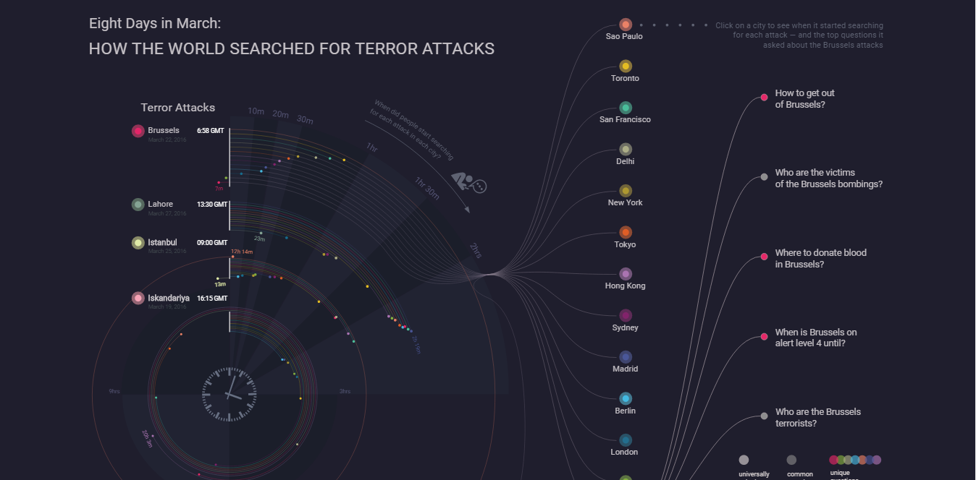
HOW THE WORLD SEARCHED FOR TERROR ATTACKS ?

Slide 36
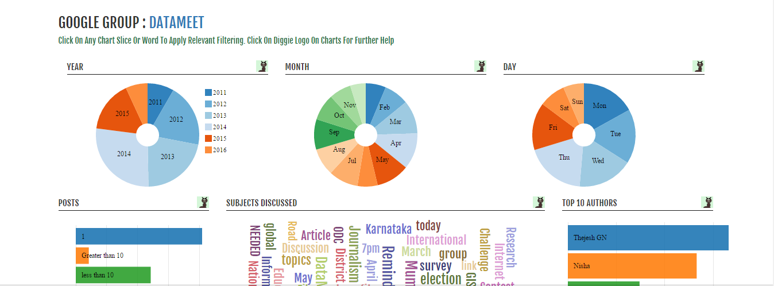
DATAMEET GOOGLE GROUP

Slide 37
BIG DATA HANDY TOOLS
Programming Languages
Python
R
Octave

Slide 38
BIG DATA HANDY TOOLS
Databases
Hadoop
Mondo DB
TeraData

Slide 39
BIG DATA HANDY TOOLS
Front End Javascript Libraries
D3.JS
Dimple Js

Slide 40
QUESTIONS?

Slide 41
THANK YOU

